Slide 1
Mathematical Foundations for ML (10-606):
Probability
Bryan Wilder
* Slides borrowed from prior offerings by Professors M. Gormley, P. Virtue, & G. Gordon, & H. Heidari.

Slide 2
Probability Vocab
Outcomes
Sample space
Events
Probability
Random variable
Discrete random variable
Continuous random variable
Probability mass function
Probability density function
Parameters

Slide 3
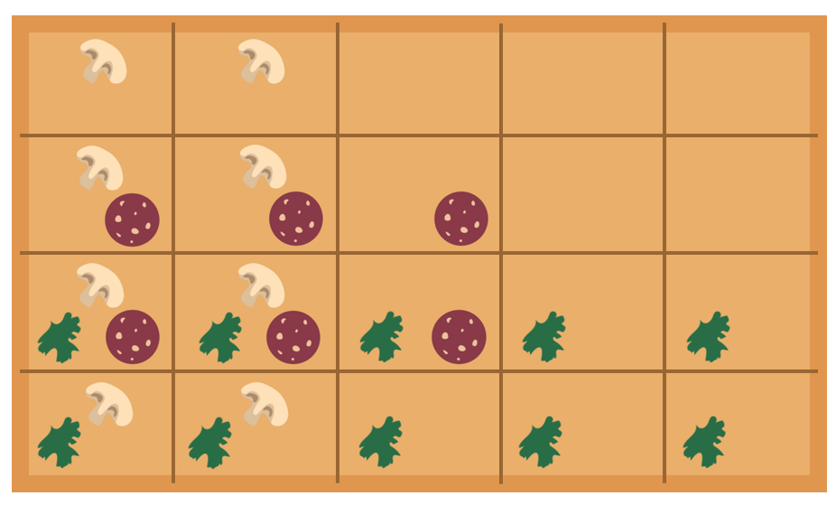




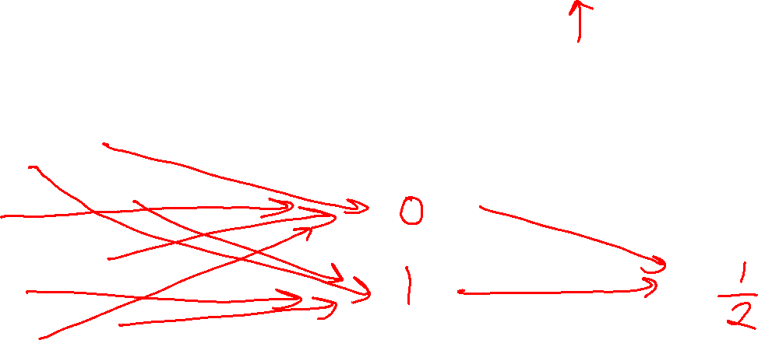
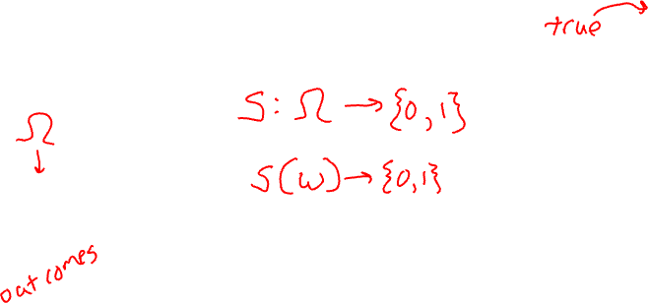
Example
Random variable for spinach or no spinach
Random variable
Distribution
Sample space
Values of a RV
Probabilities or Densities
Icons: CC, https://openclipart.org/detail/296791/pizza-slice

Slide 4
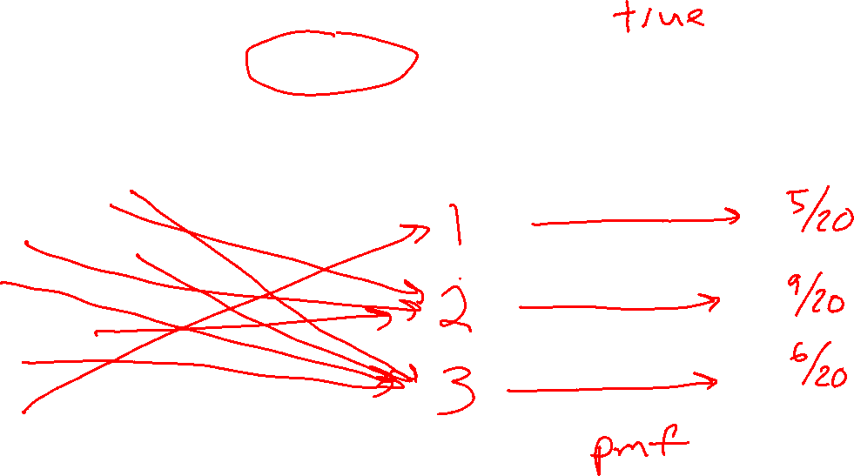
Example
Random variable for topping type with
three categories: none, non-meat, meat
Random variable
Distribution
Sample space
Values of a RV
Probabilities or Densities
Icons: CC, https://openclipart.org/detail/296791/pizza-slice

Slide 5
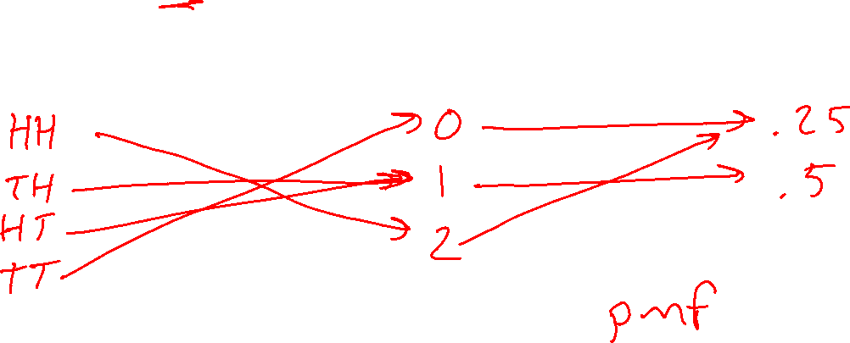
Example
Random variable for number of heads after two flips of a fair coin
Random variable
Distribution
Sample space
Values
Probabilities or Densities
Icons: CC, https://openclipart.org/detail/296791/pizza-slice

Slide 6
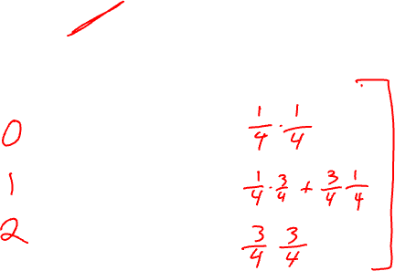
Example
Random variable for number of heads after two flips of a biased coin with heads 75%
Random variable
Distribution
Sample space
Values
Probabilities or Densities
Icons: CC, https://openclipart.org/detail/296791/pizza-slice

Slide 7
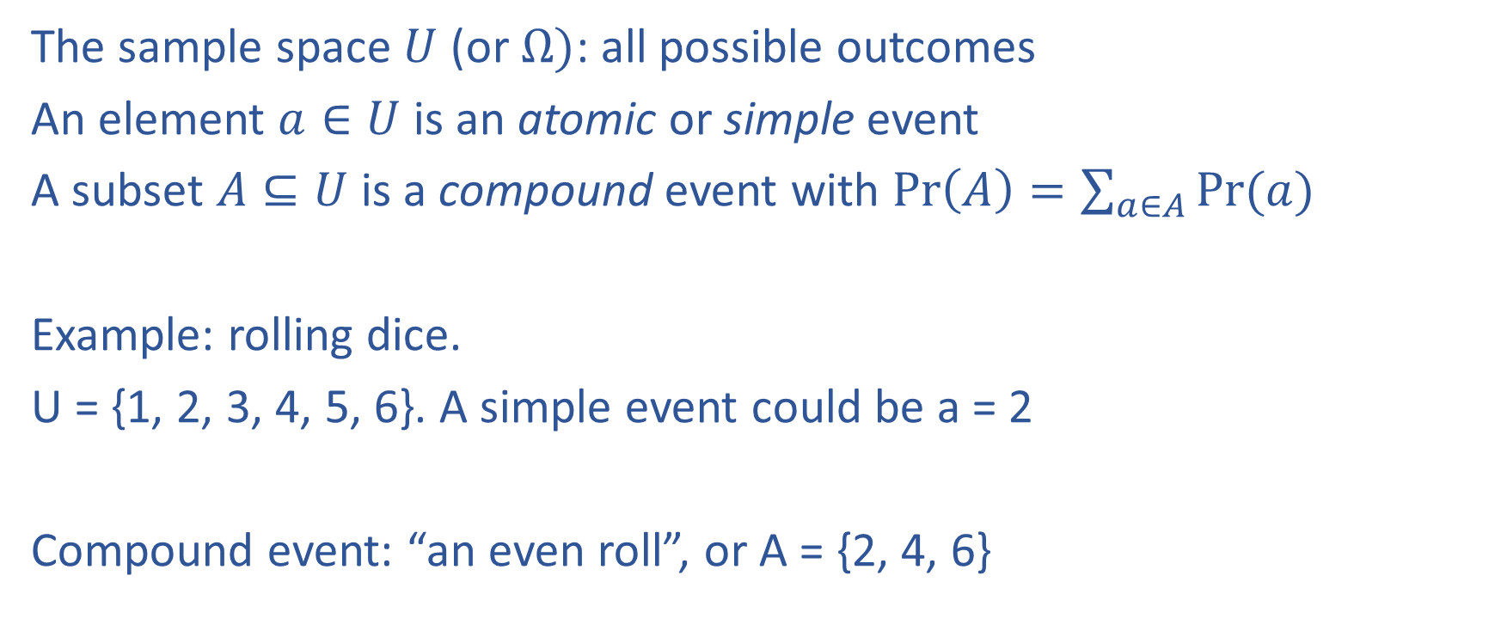
Formalization
The sample space $U$ (or $Ω)$: all possible outcomes
An element $a∈U$ is an atomic or simple event
A subset $A⊆U$ is a compound event with $\operatorname{Pr}\left(A\right)=\sum_{a∈A}{Pr⁡(a)}$
Example: rolling dice.
U = {1, 2, 3, 4, 5, 6}. A simple event could be a = 2
Compound event: “an even roll”, or A = {2, 4, 6}

Slide 8
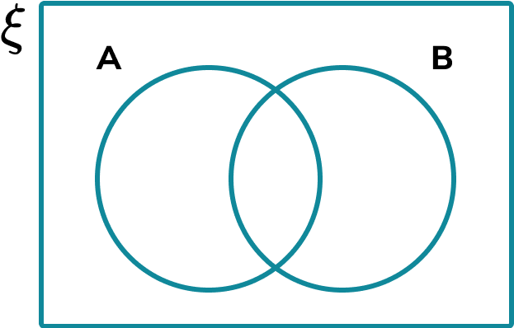
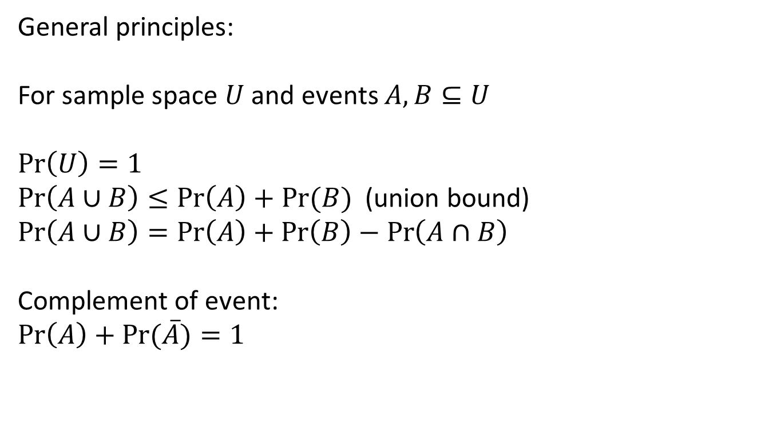
Formalization
General principles:
For sample space $U$ and events $A, B⊆U$
$$\operatorname{Pr}\left(U\right)=1$$
$\operatorname{Pr}\left(A∪B\right)≤\operatorname{Pr}\left(A\right)+Pr⁡(B)$ (union bound)
$$\operatorname{Pr}\left(A∪B\right)=\operatorname{Pr}\left(A\right)+\operatorname{Pr}\left(B\right)−\operatorname{Pr}\left(A∩B\right)$$
Complement of event:
$$\operatorname{Pr}\left(A\right)+\operatorname{Pr}{(\overline{A})}=1$$

Slide 10
Random variables
A random variable is a function of an atomic event:
“I flip a coin. If it comes up heads, I get $5. If tails, I lose $2”
f: {H, T} → R
f(H) = 5; f(T) = -2

Slide 11
Random variables
Can map to any output set
“I generate a random number uniformly in [0,1]. If it’s < 0.5, I output 0 and if >= 0.5, output 1”
f: [0,1] -> {0,1}

Slide 12
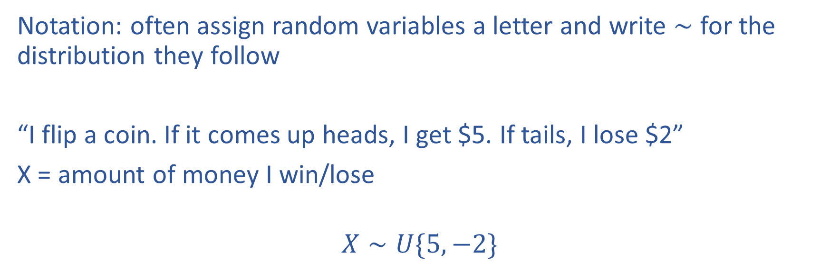
Random variables
Notation: often assign random variables a letter and write $∼$ for the distribution they follow
“I flip a coin. If it comes up heads, I get $5. If tails, I lose $2”
X = amount of money I win/lose
$$X∼U\{5, −2\}$$

Slide 13
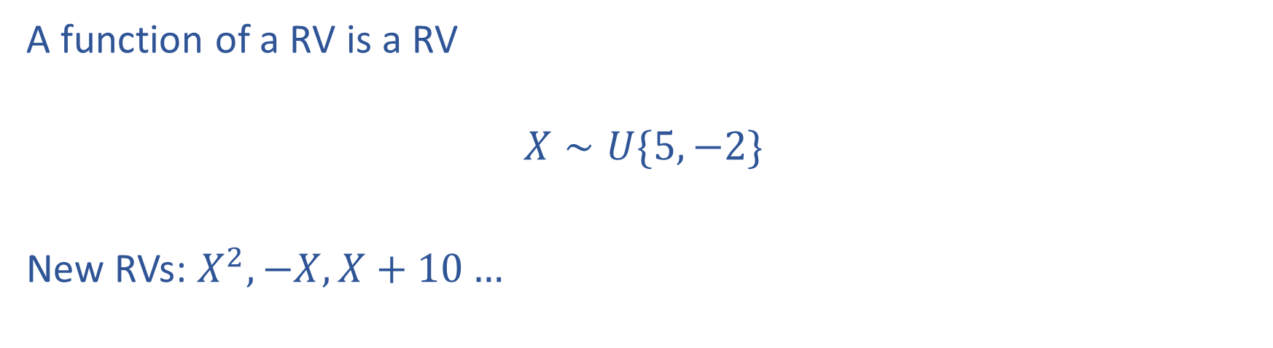
Random variables
A function of a RV is a RV
$$X∼U\{5, −2\}$$
New RVs: $X^{2}, −X, X+10…$

Slide 14
Probability table
Outcome | Probability
HH | 1/4
HT | 1/4
TH | 1/4
TT | 1/4

Slide 15
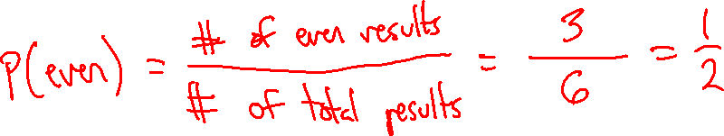
Uniform Distributions
Recall that in a uniform distribution, each atomic event has an equally likely chance of occurring.
In these settings, computing the probability of a compound event reduces to counting!
For example, suppose you have a fair six-sided die. The probability of rolling an even number is

Slide 16
Uniform Distributions
What is the probability of getting 3 heads in a row with a fair coin?

Slide 17
Uniform Distributions
Consider a biased coin that comes up heads with probability ¾. What is the probability of getting 3 heads total in a sequence of four flips?

Slide 18
Describing relationships between many random variables
So far: distribution over variables that were independent of one another
Now: describe joint distributions in more detail

Slide 19
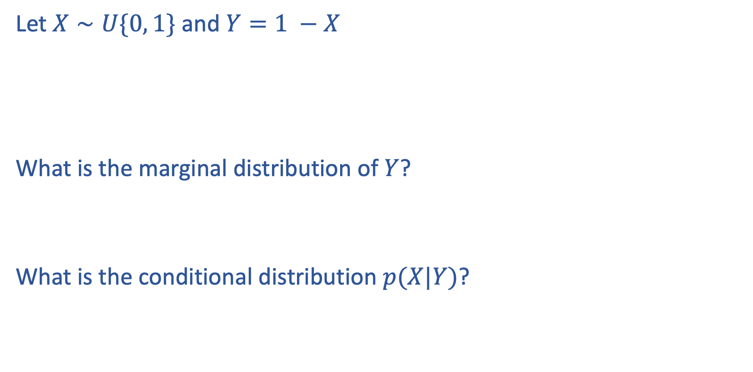
Problem
Let $X∼U\{0, 1\}$ and $Y=1 −X$
What is the marginal distribution of $Y$?
What is the conditional distribution $p(X|Y)$?

Slide 20
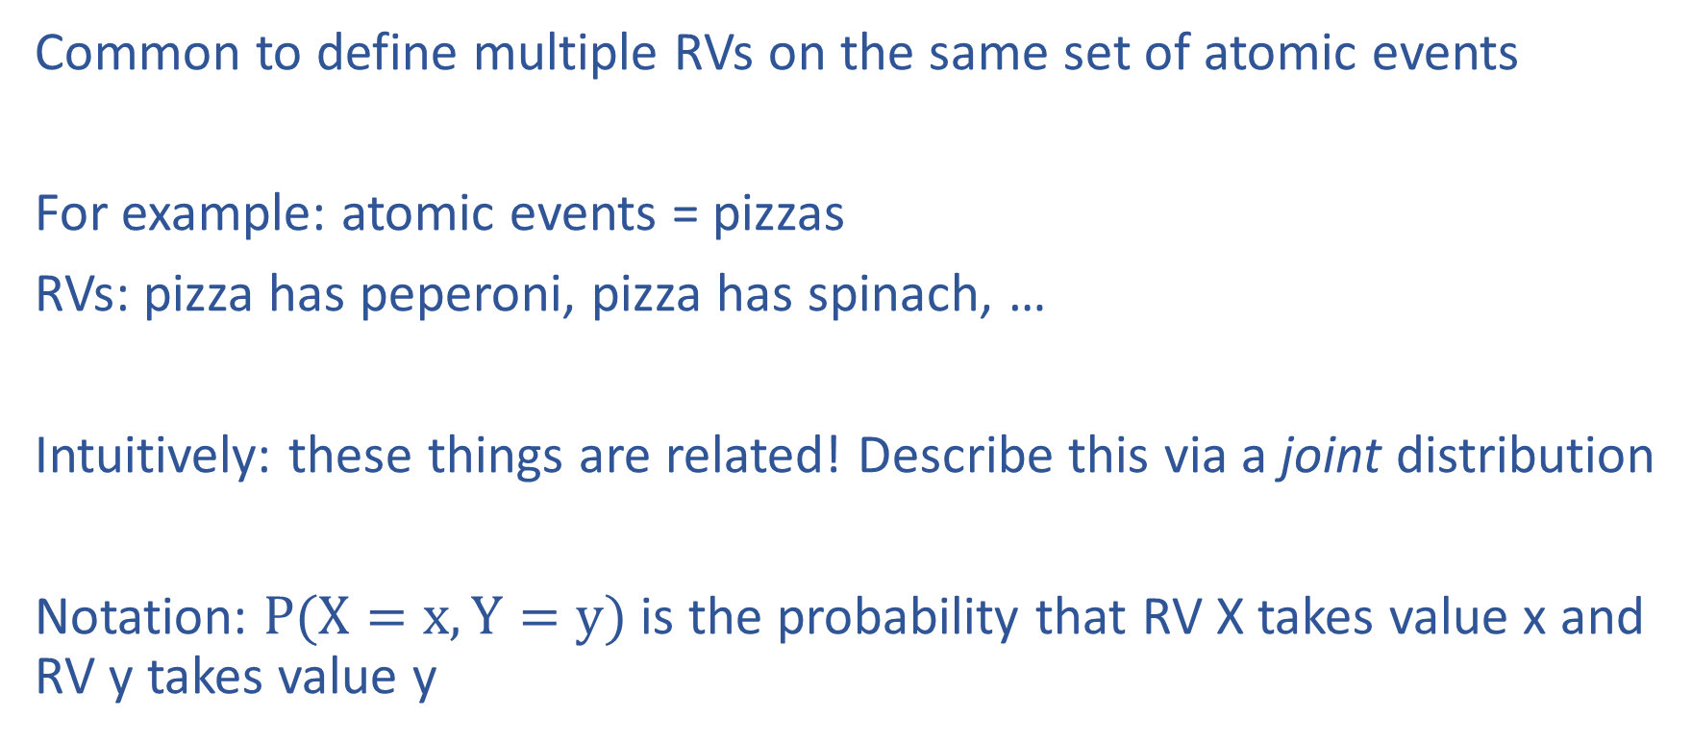
Joint distributions
Common to define multiple RVs on the same set of atomic events
For example: atomic events = pizzas
RVs: pizza has peperoni, pizza has spinach, …
Intuitively: these things are related! Describe this via a joint distribution
Notation: $P(X=x, Y=y)$ is the probability that RV X takes value x and RV y takes value y

Slide 21

Joint probabilities
 | Peperoni = 1 | Peperoni = 0
Spinach = 1 | 1/2 | 1/8
Spinach = 0 | 1/8 | 1/4
Sample space is U = {(0, 0), (0, 1), (1, 0), (1, 1)}
Cells sum to 1: $\operatorname{Pr}\left(a∈U\right)=1$

Slide 22
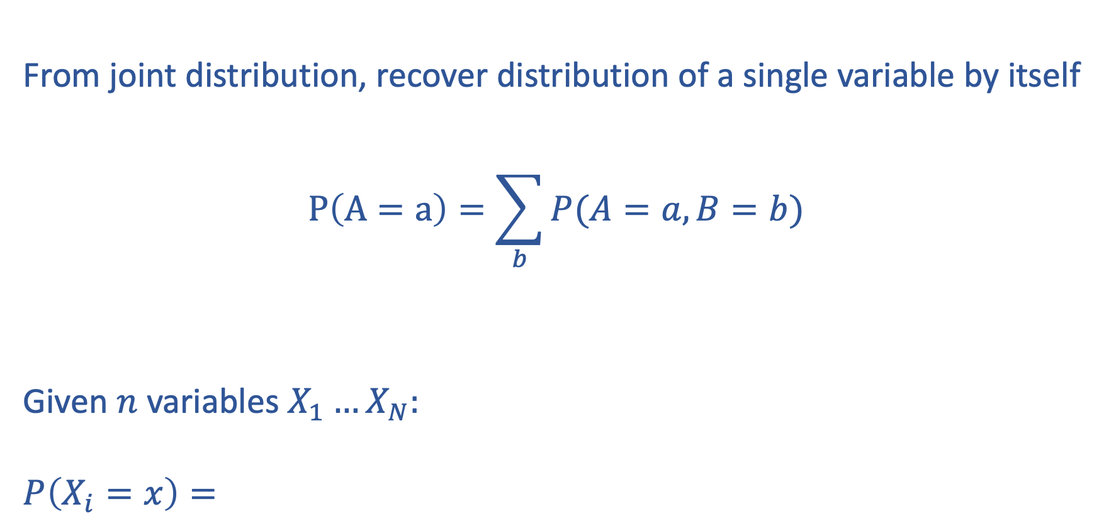
Marginalization over distributions of many variables
From joint distribution, recover distribution of a single variable by itself
$$P\left(A=a\right)=\sum_{b}{P(A=a, B=b)}$$
Given $n$ variables $X_{1}…X_{N}:$
$$P\left(X_{i}=x\right)=$$

Slide 23

Conditional probability
$$p\left(A | B\right)=\frac{p\left(A, B\right)}{p(B)}$$
Interpretation: probability A happens given B happened

Slide 24
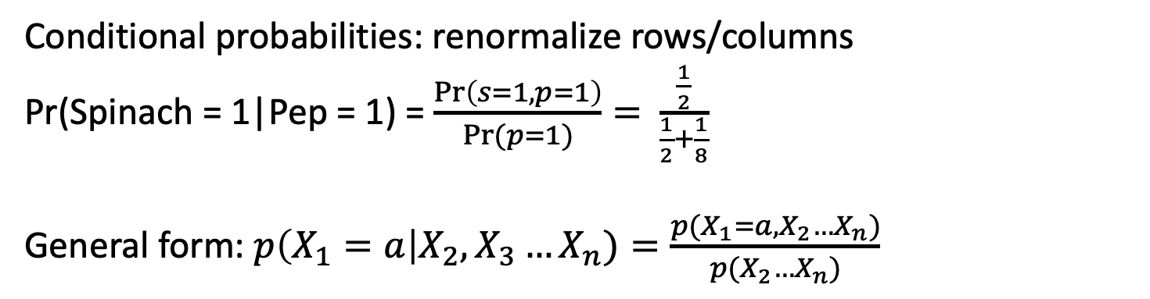
Probability table: joint probabilities
 | Peperoni = 1 | Peperoni = 0
Spinach = 1 | 1/2 | 1/8
Spinach = 0 | 1/8 | 1/4
Conditional probabilities: renormalize rows/columns
Pr(Spinach = 1|Pep = 1) = $\frac{\operatorname{Pr}\left(s=1,p=1\right)}{\operatorname{Pr}{(p=1)}}=$ $\frac{\frac{1}{2}}{\frac{1}{2}+\frac{1}{8}}$
General form: $p\left(X_{1}=a\right|X_{2}, X_{3}…X_{n})=\frac{p(X_{1}=a, X_{2}…X_{n})}{p(X_{2}…X_{n})}$

Slide 25
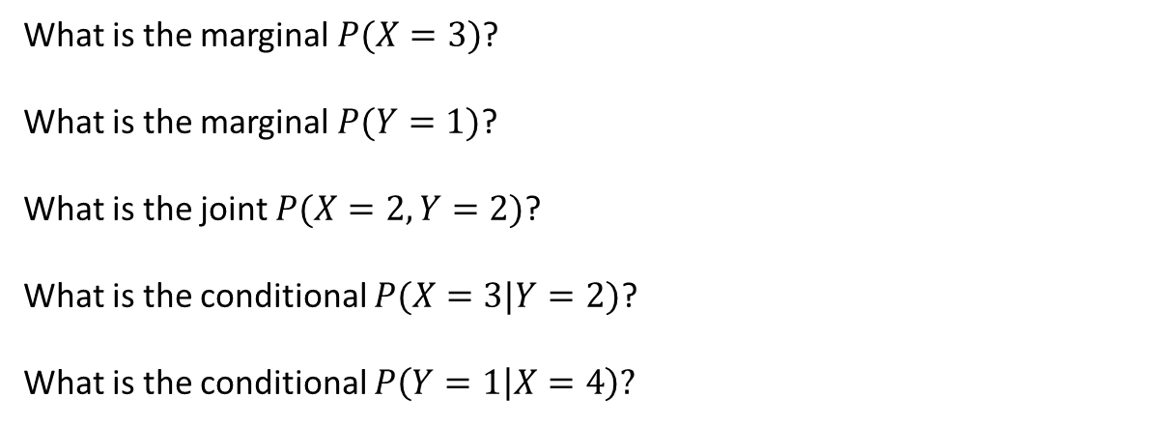
Probability table
X/Y | 1 | 2
0 | 0.1 | 0.1
1 | 0.2 | 0
2 | 0.05 | 0.1
3 | 0.15 | 0.1
4 | 0.05 | 0.15
What is the marginal $P(X=3)$?
What is the marginal $P(Y=1)$?
What is the joint $P(X=2, Y=2)$?
What is the conditional $P(X=3|Y=2)$?
What is the conditional $P\left(Y=1 | X=4\right)?$

Slide 26
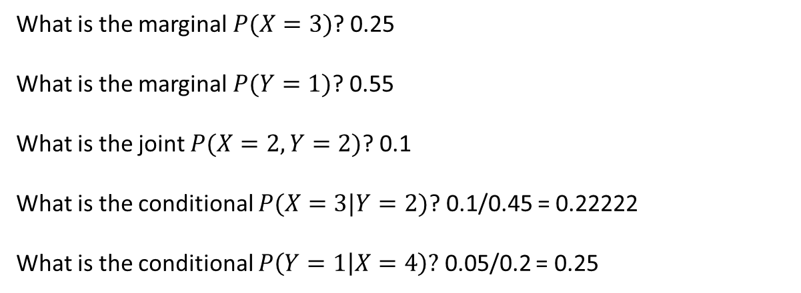
Probability table
X/Y | 1 | 2
0 | 0.1 | 0.1
1 | 0.2 | 0
2 | 0.05 | 0.1
3 | 0.15 | 0.1
4 | 0.05 | 0.15
What is the marginal $P(X=3)$? 0.25
What is the marginal $P(Y=1)$? 0.55
What is the joint $P(X=2, Y=2)$? 0.1
What is the conditional $P(X=3|Y=2)$? 0.1/0.45 = 0.22222
What is the conditional $P\left(Y=1 | X=4\right)?$ 0.05/0.2 = 0.25

Slide 27
You look at pizzas coming out of the oven at your local pizza place. 50% have spinach and 30% have peperoni. 30% have neither spinach or peperoni. What is the probability that a pizza has both?
Notes:
Pr(s = 1) = 0.5
Pr(p = 1) = 0.3
Pr(p = 0, s = 0) = 0.3
Pr(p = 0, s= 1) + Pr(p = 0, s = 0) = Pr(p = 0) = 1 – Pr(p = 1) = 0.7
Pr(p = 0, s= 1) = 0.4
Pr(p = 0, s = 0) + Pr(p = 1, s = 0) = Pr(s = 0) = 1 – Pr(s = 1) = 0.5
Pr(p = 1, s = 0) = 0.2
Pr(p = 1, s = 1) = 1 – (Pr(p = 0, s = 0) + Pr(p = 1, s = 0) + Pr(p = 0, s = 1)) = 0.1

Slide 28
You look at pizzas coming out of the oven at your local pizza place. 50% have spinach and 30% have peperoni. 30% have neither spinach or peperoni. What is the probability that a pizza has both?
Pr(s = 1) = 0.5
Pr(p = 1) = 0.3
Pr(p = 0, s = 0) = 0.3

Slide 29
You look at pizzas coming out of the oven at your local pizza place. 50% have spinach and 30% have peperoni. 30% have neither spinach or peperoni. What is the probability that a pizza has both?
Pr(s = 1) = 0.5
Pr(p = 1) = 0.3
Pr(p = 0, s = 0) = 0.3
Pr(p = 0, s= 1) + Pr(p = 0, s = 0) = Pr(p = 0) = 1 – Pr(p = 1) = 0.7
Pr(p = 0, s= 1) = 0.4

Slide 30
You look at pizzas coming out of the oven at your local pizza place. 50% have spinach and 30% have peperoni. 30% have neither spinach or peperoni. What is the probability that a pizza has both?
Pr(s = 1) = 0.5
Pr(p = 1) = 0.3
Pr(p = 0, s = 0) = 0.3
Pr(p = 0, s= 1) + Pr(p = 0, s = 0) = Pr(p = 0) = 1 – Pr(p = 1) = 0.7
Pr(p = 0, s= 1) = 0.4
Pr(p = 0, s = 0) + Pr(p = 1, s = 0) = Pr(s = 0) = 1 – Pr(s = 1) = 0.5
Pr(p = 1, s = 0) = 0.2

Slide 31
You look at pizzas coming out of the oven at your local pizza place. 50% have spinach and 30% have peperoni. 30% have neither spinach or peperoni. What is the probability that a pizza has both?
Pr(s = 1) = 0.5
Pr(p = 1) = 0.3
Pr(p = 0, s = 0) = 0.3
Pr(p = 0, s= 1) + Pr(p = 0, s = 0) = Pr(p = 0) = 1 – Pr(p = 1) = 0.7
Pr(p = 0, s= 1) = 0.4
Pr(p = 0, s = 0) + Pr(p = 1, s = 0) = Pr(s = 0) = 1 – Pr(s = 1) = 0.5
Pr(p = 1, s = 0) = 0.2
Pr(p = 1, s = 1) = 1 – (Pr(p = 0, s = 0) + Pr(p = 1, s = 0) + Pr(p = 0, s = 1)) = 0.1

Slide 32
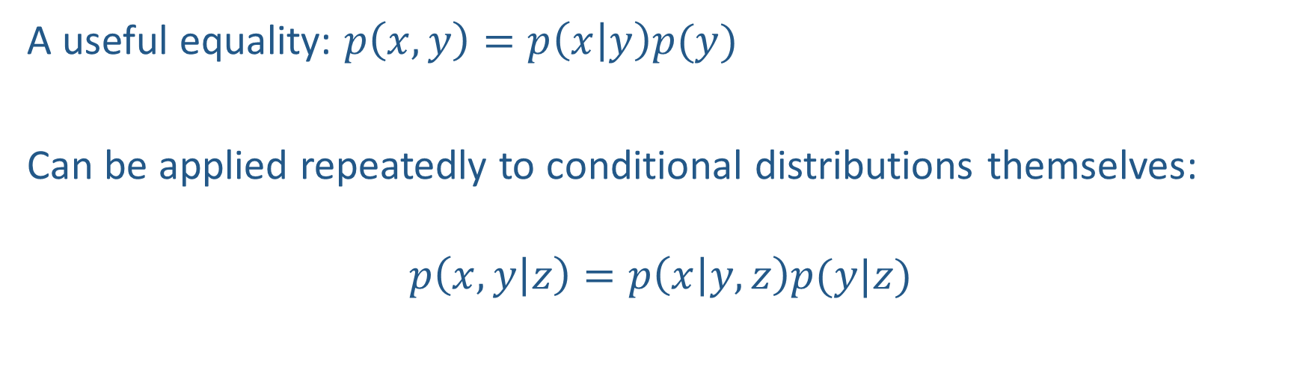
The chain rule
A useful equality: $p\left(x,y\right)=p\left(x | y\right)p(y)$
Can be applied repeatedly to conditional distributions themselves:
$$p\left(x, y | z\right)=p\left(x | y,z\right)p(y|z)$$

Slide 33
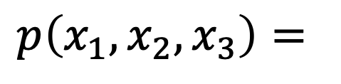
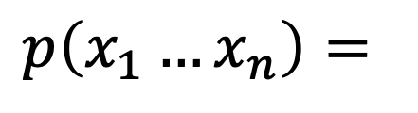
The Chain Rule
More generally, can always write any joint distribution as an incremental product of conditional distributions
$$p\left(x_{1}, x_{2},x_{3}\right)=$$
$$p\left(x_{1}…x_{n}\right)=$$
Notes:
Show multiple different factorizations

Slide 34
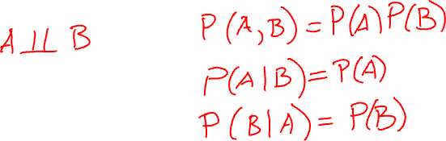
Independence
Variables where knowing one does not reveal any information about the other
Notes:
A \perp B
P(A, B) = P(A, B)
P(A|B) = P(A)
P(B|A) = P(B)

Slide 35
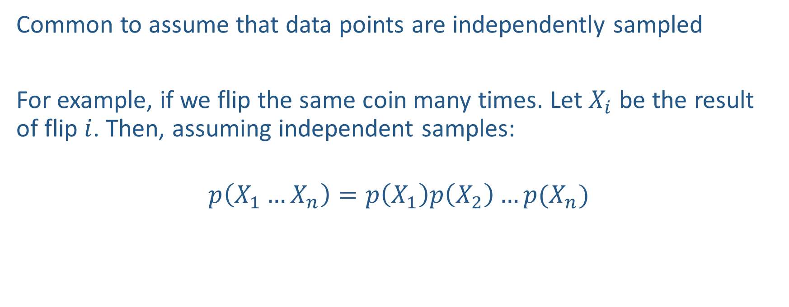
Independent samples
Common to assume that data points are independently sampled
For example, if we flip the same coin many times. Let $X_{i}$ be the result of flip $i$. Then, assuming independent samples:
$$p\left(X_{1}…X_{n}\right)=p\left(X_{1}\right)p\left(X_{2}\right)…p(X_{n})$$

Slide 36
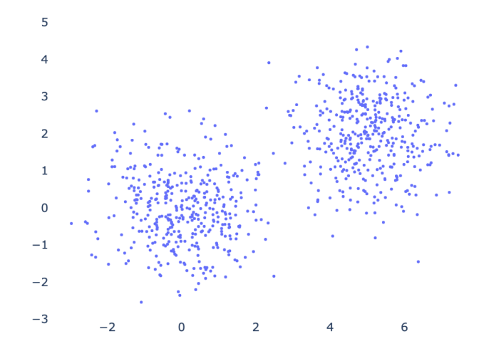
Conditional independence

Slide 37


Conditional Independence

